Slide 1
Advantage:
It is cost-effective as the customer handles the web application himself and does not go for professional service. This saves time as it accelerates every aspect of the management of employee databases and payroll processes with a number of automated features.
The main advantage of this database is that it reduces the number of input requirements, avoids delays, records errors and manages the steps easily. Insertion, data update, deletion, modules for pay slips are included.

Slide 2
Problem statement:
Due to the vast volume of payroll data and projections, it is very hard to manually handle the data and prolong the pay roll process. This produced an urgent need to incorporate a new computer-based pay roll data base system to avoid the delay in generating pay bills, loan schedules, payment reports, pay slips and so on. So this new Employee Pay roll Management System is developed.
To create a database that can be used by an employer to keep track of their workers. We need a way to represent a single worker and a way to maintain an unknown number of workers (name, ID number, salary)

Slide 3
It is important to improve the ability to add or delete employees from the database and to include some other features described below:
Add Employee
Remove Employee
Print By Name

Slide 4
Project Objectives:
Employee Database and Payroll Management System is designed to make the current manual system automatic and to meet their needs so that their essential information and data can be processed over a longer period of time with easy access and handling
There are several employee and payroll management requirements for every company. Therefore we are aimed to establish an 6 exclusive employee and payroll management system customize to the Managerial Requirements of the organization.
A computer program can maintain a precise and reliable database, leading to improved performance.

Slide 5
Software Requirements:
External Interface Specifications
Interfaces optimized for users:
The software offers a decent graphical interface for the self-explanatory front end.

Slide 6
Interfaces in hardware
Minimum 2 GB RAM memory
40 GB hard disc
Mouse
Keyboard
Printer

Slide 7
Interfaces in the apps
The Used Editor:
Dreamweaver for PHP, WAMP server for MySQL
Operating System: Windows 10

Slide 8
For PHP Dreamweaver:
PHP is a server-side application that dynamically constructs web pages
Creating authentication systems, downloading files, and sending emails are other uses of PHP. PHP or a related server-side technology is used for just about every online shop, news website, forum, or social networking site
PHP code may be inserted into a web page or stored in external files, depending on how it is used. However, PHP code still stays on the web server, unlike CSS or JavaScript.

Slide 9
MySQL's WAMP server:
MySQL is an open source relational database management system (RDBMS) based on the Structured Query Language (SQL) backed by Oracle (SQL)
MySQL operates on almost all platforms, including Linux, UNIX and Windows. Although it may be used in a wide range of applications
A major component of LAMP, an open source enterprise stack, is MySQL
MySQL is a relational database management system and the PHP object-oriented scripting language.

Slide 10
JSP:
JSP stands for "Java Server Page."
JSP pages are the same as ASP pages because they are compiled on the server and not on a user's Web browser.
JSP pages are useful for building interactive Web sites and accessing database data from the Web server.
On the server, all Java code is parsed, while JSP pages would have HTML interspersed with Java.

Slide 11
Functional demands
Admin:
The administrator logs in with a username and password that is correct.
The administrator may hire new workers, add new departments, and add new pay scales for employees.
The admin will view all the previous records of any registered employee.
Add new employee:
This module contains equipment that allows a user to add new records.
Before the new employee record user is introduced, the usable ID in the respective system has to be checked.

Slide 12
Delete employee:
Often the circumstance arises that we need to remove from our database the required employee record. In this case, this facility is provided by the Remove Employee module to delete a particular employee's record.
Update employee:
Using the Employee Module Update, whether the user wants to update the specifics of a current employee as Grade Pay, Basic Pay, Designation, any miscellaneous deduction or credit.

Slide 13
Pay slip:
This module is used to generate the pay slips of all workers for the current month.
Report:
This module enables administrative reports to be made, such as the Wage Report, Attendance Report. The report and the employee report can be exported to Word, pdf.

Slide 14
Performance requirements:
The overall scheme should be quick and error free.
For error testing and correction, it should have built-in facilities.
The computer should be able to handle large amounts of data conveniently.

Slide 15
Attributes
Reliability
This framework is created to ensure reliability using software that has been developed.
To be stable and easy to use.
Availability
This system is designed to run 24/7
It is also conveniently accessible to the user.

Slide 16
Security
Entry to the program is given to only legitimate operators.
We need a clear ID and Password to get access to the app.

Slide 17
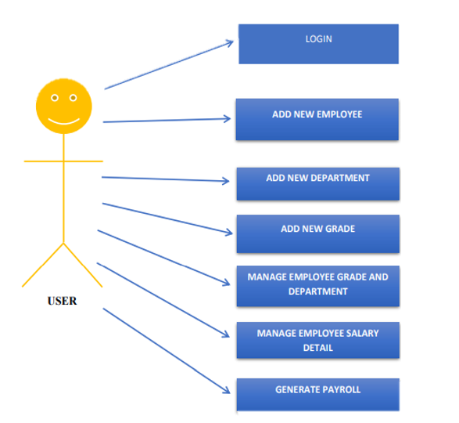
Software Design
User case Diagram:

Slide 18
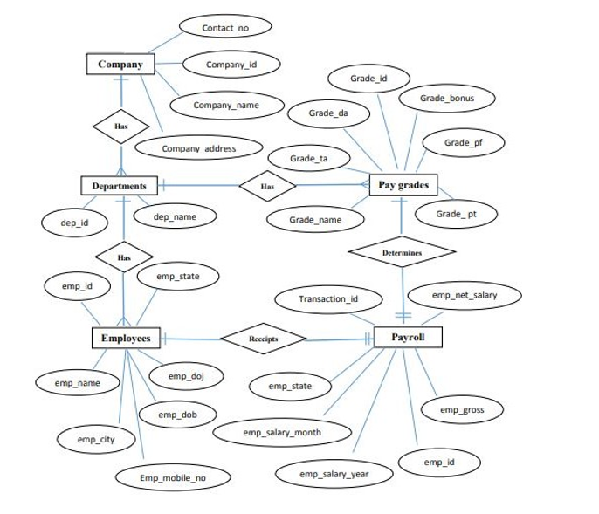
ER-Diagram:

Slide 19
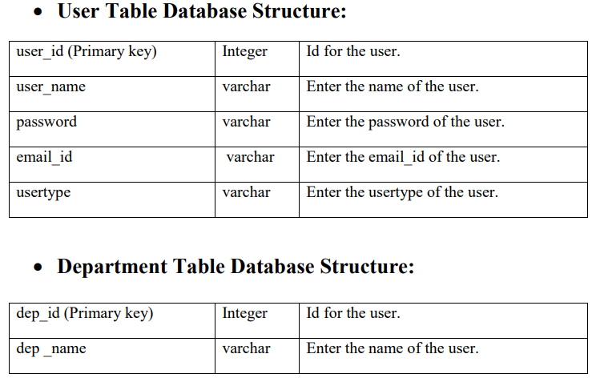
File data fields:

Slide 20
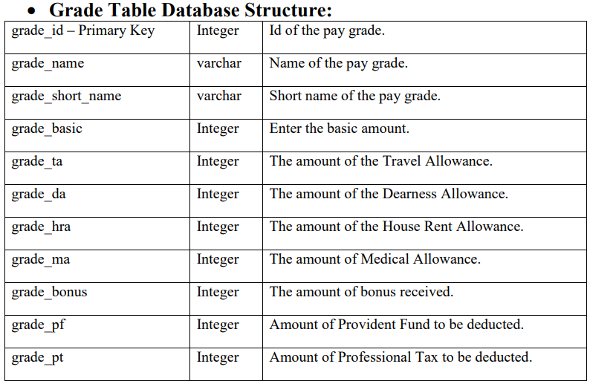

Slide 21
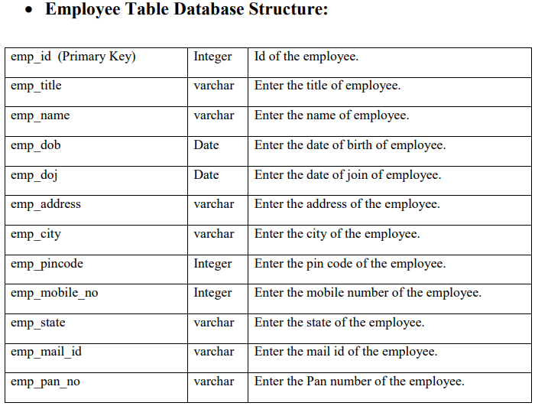

Slide 22
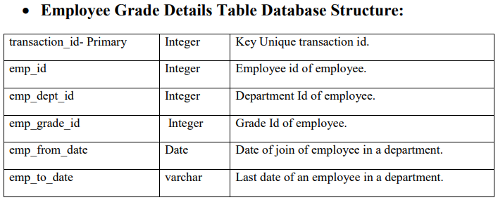

Slide 23
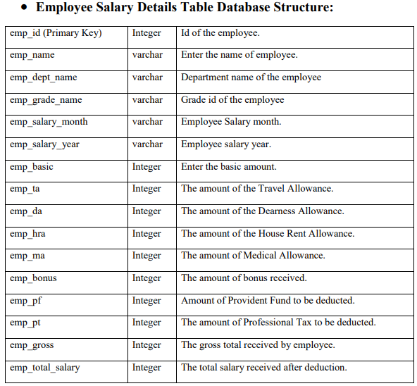

Slide 24
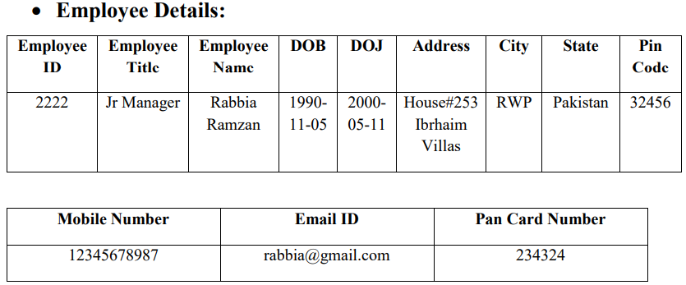
Output design:
We will enter the employee’s name and the performance will be displayed afterwards.

Slide 25
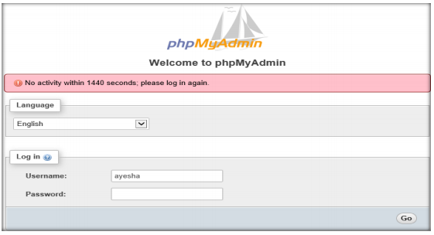
Software Implementation
FRONT END IMPLEMENTATION
Sign-up page :

Slide 26
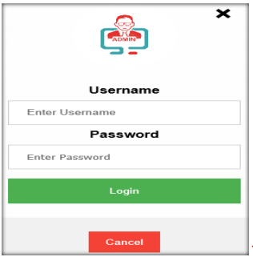
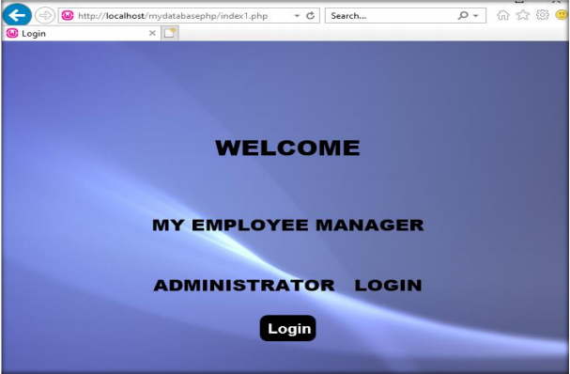
Login:

Slide 27
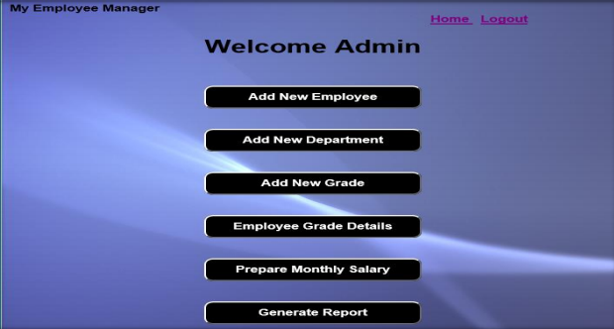
Welcome Page

Slide 28
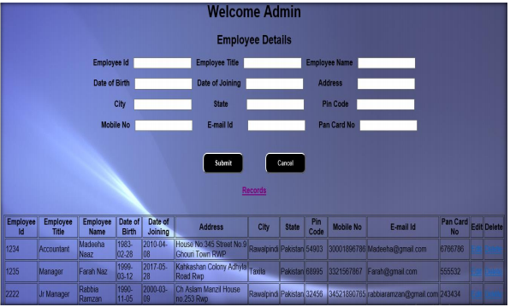
Employee details

Slide 29
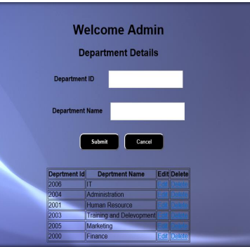
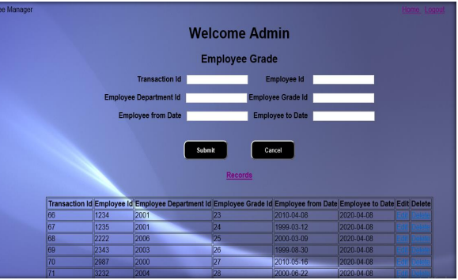
Department Details & Add grades :

Slide 30
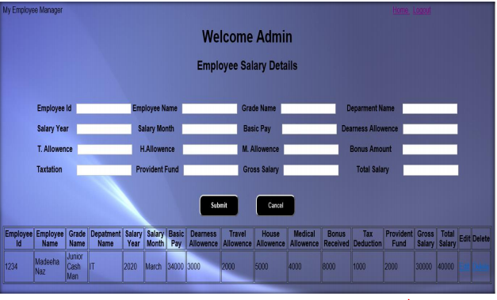
Employee Salary Details Page:

Slide 31
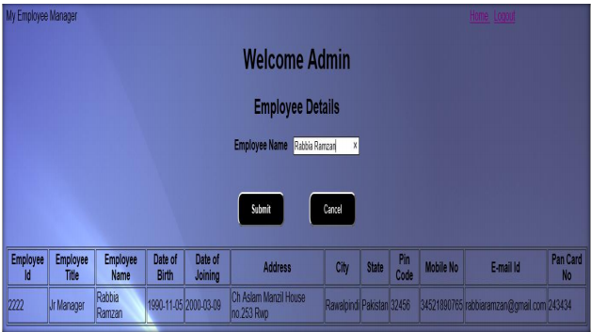
Report:

Slide 32
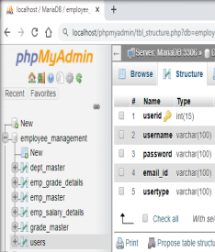
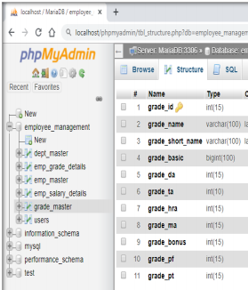
BACK-END IMPLEMENTATION:
User table data: Grade table data:

Slide 33
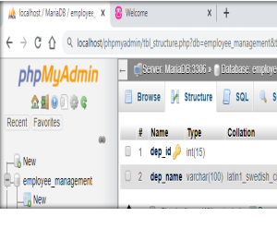
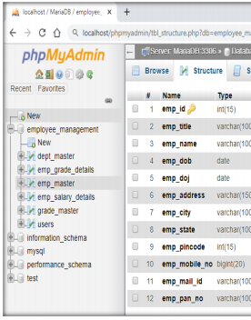
Department table data: Employee Table Data:

Slide 34
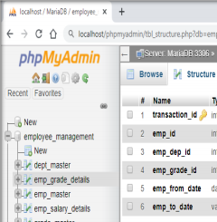
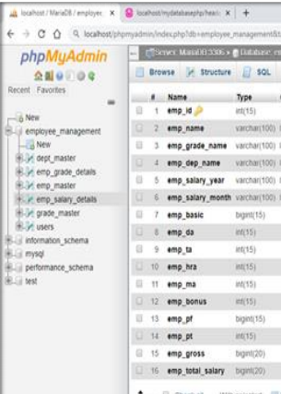
Grade Table Data: Employee Salary Table:

Slide 35
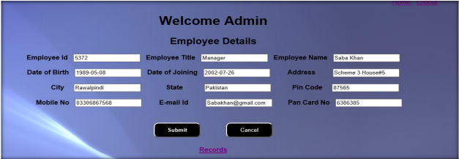
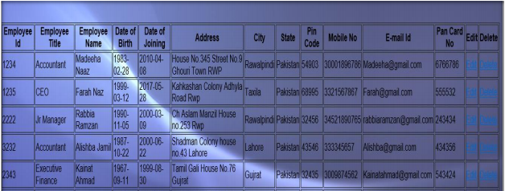
Software Testing
Normal Data

Slide 36
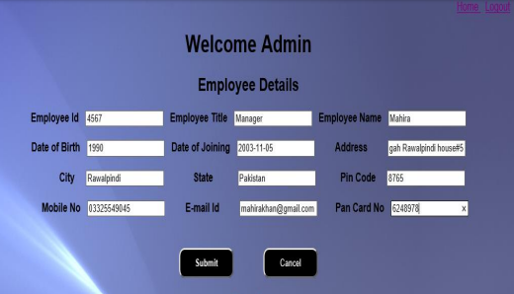

Exceptional Data

Slide 37
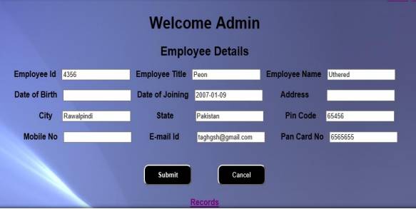

All fields required error

Slide 38
Conclusion:
Technology designed by a corporation for "Payroll management system” has been developed to achieve optimum productivity and minimize payroll activities. MySQL and PHP is used for the database by the framework as the front end. The device is robust enough to survive regular regressive operations in conditions that sustain and clear the database over a period of time.

Slide 39
Thank You!

